Slide 1

現代管理學 ch1 管理者與管理
1-<number>

Slide 2
4
Managing the Environment

Slide 3
Learning Objectives
Understand what the external environment is and why it matters。
How the external environment affects managers。
Define organizational culture and explain its importance。
How organizational culture influences managers。
2-<number>

Slide 4
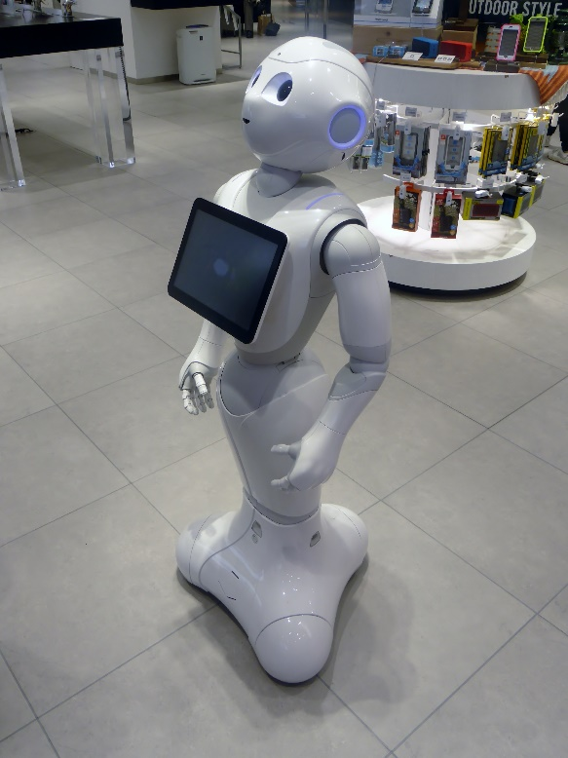
個案介紹:老年照護機器人
日本愈趨嚴重的少子化、高齡化、失智症人數上升等，引發照護人力短缺問題，使企業積極生產照護機器人
目前各企業研發的機器人功能有：陪老人做運動、說話、記錄身體狀況，甚至輔助老人出門步行
1-<number>

Slide 5
1. The Omnipotent? View of Management
Managers are directly responsible for an organization’s performance。
  Performance differences stem from variations in managers’ decisions and actions。
1-<number>

Slide 6
2. Symbolic View of Management
Managers’ influence over organizational outcomes is not unlimited; it is constrained by external factors。
  These include economic conditions, customers, government policies, competitors’ actions, industry conditions, and decisions made by previous managers。
Managers symbolically control and influence organizational operations.
1-<number>

Slide 7
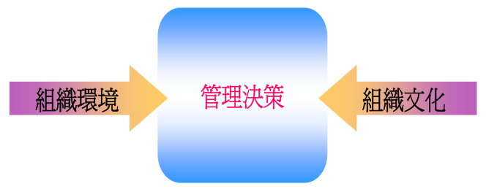
3. The Integrated ? Perspective
Managers’ decisions and actions are subject to numerous constraints: internal limitations primarily stem from organizational culture, while external constraints arise from the organization’s external environment。.
1-<number>

Slide 8



A. What Is the External Environment?
When Iceland’s volcano erupted in 2010, it caused production halts at BMW’s factory in South Carolina, USA, and Nissan’s assembly plants in Japan.
External environment (外部環境)
  Factors such as interest rates, inflation, changes in disposable income, stock market fluctuations, and phases of the economic cycle.
  Two types of environments :
    Specific environment: External forces that directly affect managerial decisions and actions and are closely tied to achieving organizational goals. 。
    General environment: Broader dimensions—including economic, political/legal, sociocultural, demographic, technological, and global factors—that may influence the organization。
2-<number>

Slide 9
Corporate Governance
  Corporate governance establishes a system among organization’s stakeholders, aiming to ensure operations and maximize the organization’s interests。
Stakeholders(利害關係人)
  Individuals or groups affected by an organization’s decisions and actions。
    Examples of stakeholders include employees, labor unions, shareholders, creditors, local communities, suppliers, distributors, customers, competitors, and government 。
For instance, Starbucks’ decisions and actions affect coffee farmers, employees, customers, other coffee businesses, and local communities—all of whom, in turn, influence Starbucks’ managerial decisions。
1-<number>

Slide 10
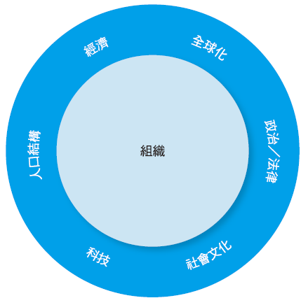
What Is the External Environment? Why Is It Important?
Components of the External Environment
2-<number>

Slide 11
What Is the External Environment? Why Is It Important?
  Elements of the General Environment
    Demographic Elements
      Include age, race, gender, education level, geographic location, income, and family composition.
    Technological Elements
      Concern scientific or industrial innovations.
    Sociocultural Elements
      Encompass values, attitudes, trends, traditions, lifestyles, beliefs, tastes, and behavioral patterns.
    Political/Legal Elements
      Focus on national and local laws, as well as international and global regulations.
    Global Elements
      Involve issues related to globalization and the world economy.
2-<number>

Slide 12
How Is the Economic Landscape Changing?
The World Economic Forum identifies two major risks facing business leaders and policymakers over the next decade: extreme income inequality and chronic fiscal imbalances.
Economic inequality and the economic context(經濟不平等與經濟環境)。
  Historically, hard work and creativity have been rewarded—but income disparities(所得差距) persist.
  So, should we still work hard?
2-<number>

Slide 13
What Role Does Demographics Play?
Demography is destiny (人口就是命運)
  A nation’s population size and characteristics significantly shape its future.
  Experts predict that by 2050, emerging economies led by India and China will surpass developed economies in scale.
Demographics—the study of population characteristics—influences how managers lead and make decisions。.
2-<number>

Slide 14
What Role Does Demographics Play?
Age is a particularly critical demographic factor.
  Multiple generations now work together.
  嬰兒潮(Baby Boomers)、X世代(Gen X)、Y世代(Gen Y)、後千禧世代(Post-Millennials) 。Baby Boomers, Generation X, Generation Y (Millennials), and Post-Millennials (Gen Z).
Generational cohorts(年齡族群) are crucial in management studies because large population segments at specific life-cycle stages can constrain decision-making and actions by businesses, governments, educational institutions, and other organizations.
2-<number>

Slide 15
A.1 How Does the External Environment Affect Managers?
Three key ways to examine the external environment’s impact:
  Effects on jobs and employment
  Environmental uncertainty
  Stakeholder relationships
2-<number>

Slide 16
How Does the External Environment Affect Managers?
jobs and employment
  During global economic downturns, jobs vanish, and unemployment rises to levels unseen in decades.
  Of the 8.4 million jobs lost in the U.S. during the recession, one-quarter will never return—they’ll be replaced by new roles in growing industries.
    The “short chain” problem
  Managers must balance workforce demands with the availability of personnel possessing the necessary skill。
  外部條件改變不只會影響可獲得的工作型態，還會影響到如何設立、管理那些工作。Changing external conditions not only affect the types of jobs available but also how those jobs are designed and managed
2-<number>

Slide 17
How Does the External Environment Affect Managers?
Environmental uncertainty
  A frequently changing environment is termed “dynamic”; one with minimal change is “stable.”
  Environmental complexity refers to the number of external factors affecting an organization and the organization’s understanding of those factors.
1-<number>

Slide 18
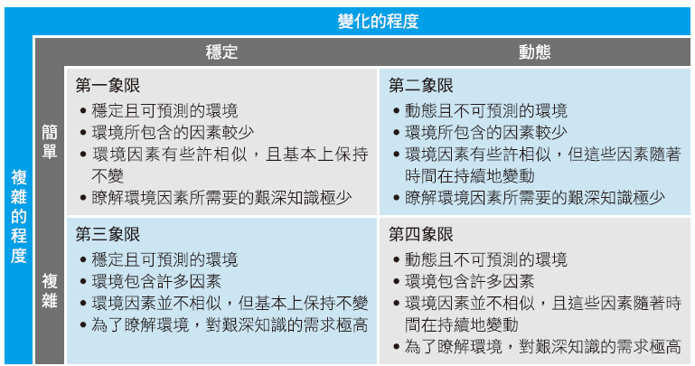
How Does the External Environment Affect Managers?
Environmental Uncertainty Matrix
1-<number>

Slide 19
How Does the External Environment Affect Managers?
Environmental Uncertainty
  Quadrant 1 (stable and simple environment) represents the lowest level of uncertainty，
  Quadrant 4 (dynamic and complex environment) represents the highest level of uncertainty。
Managers prefer operating in environments with minimal uncertainty—but this is often beyond their control。
2-<number>

Slide 20
How Does the External Environment Affect Managers?
Managing stakeholder relationships
  Stakeholders are any individuals or groups affected by—or who affect—an organization’s decisions and actions. They include both internal and external parties.
Why manage stakeholder relationships?
  They influence organizational outcomes. 。
  Effective stakeholder management leads to better environmental forecasting, more successful innovation, stronger trust among stakeholders, and greater organizational resilience to change。
2-<number>

Slide 21
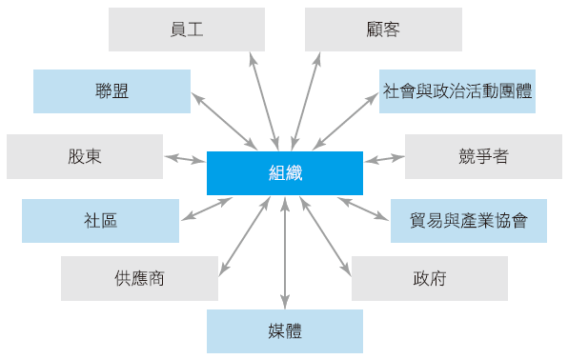

How Does the External Environment Affect Managers?
Organizational Stakeholders
2-<number>

Slide 22
How Does the External Environment Affect Managers?
  Organizations rely on external groups as sources of inputs (resources) and as channels for outputs (goods and services). Thus, managers must consider stakeholders’ interests when making decisions.
  How Does the External Environment Affect Managers?
    Identify who the stakeholders are。
    Understand what matters to them。
    Assess their influence on organizational decisions and actions。
    Determine how to effectively manage each stakeholder group。
2-<number>

Slide 23

B. What Is Organizational Culture?
Organizational culture ()
  Shared values, principles, and traditions that shape and influence members’ behavior.
  Like a unique personality that affects how people act and interact. Organizations, too, have personalities.
Culture is perceptual(知覺)—it is sensed and experienced.
Culture is descriptive(描述性)—it characterizes “how things are done around here.”
Culture is a shared(共享) pattern
  It is rarely written down, yet organizational culture undeniably exists.
2-<number>

Slide 24

走過食安風暴的良心企業—義美食品
義美食品總經理高志明表示，義美不是靠實驗室躲過食安風暴，真正帶領義美食品在食安風暴中全身而退的，是那深植在企業之中的組織文化。（照片由聯合報系提供）

Slide 25

法藍瓷總裁用故事向員工傳達企業文化
陳立恆認為每位員工都是圓桌武士，領導者與同事都是一個團隊。法藍瓷的領導理念就是：「球賽不是靠前鋒一味的努力往前衝就可以得分，而是需要團隊合作一起得分」。（照片由聯合報系提供）

Slide 26
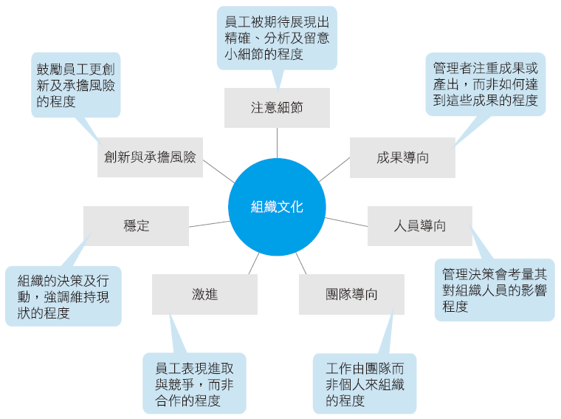
What Is Organizational Culture?
How Is Culture Described?
Dimensions of Organizational Culture
2-<number>

Slide 27

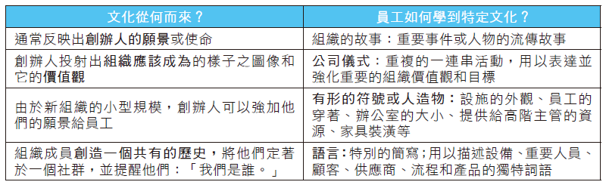
What Is Organizational Culture?
How Is Culture Described?
2-<number>

Slide 28
B.1 How Does Organizational Culture Affect Managers?
Primarily in two ways:
  It influences what employees do and how they do it，
  It shapes what managers themselves do。
Strong cultures
  Occur when core values are embraced by most employees。
  In organizations with strong cultures, culture can substitute for formal rules and controls in guiding employee behavior。
2-<number>

Slide 29
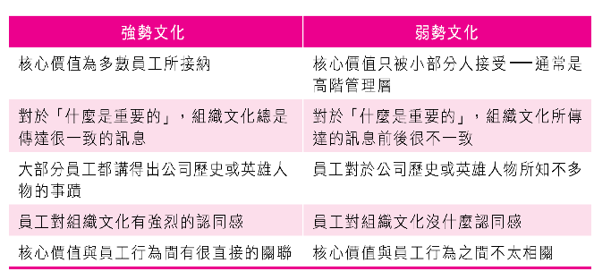
Strong Cultures
Advantages:
  Employees in strong-culture organizations exhibit higher loyalty than those in weak-culture organizations。.
Disadvantages
  Strong cultures can sometimes hinder employees from trying new approaches—especially problematic for organizations operating in rapidly changing environments.
1-<number>

Slide 30
1. Origins of Organizational Culture
Stem from founders’ philosophies
Once established, deliberate actions are needed to sustain and transmit the culture.
Senior executives’ behaviors significantly shape organizational culture。
1-<number>

Slide 31
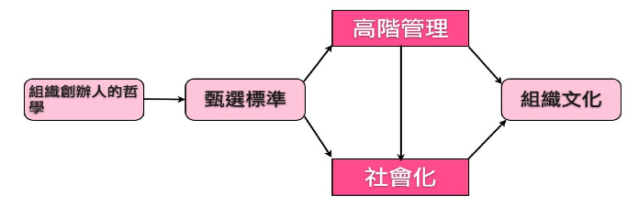
2. Sustaining Organizational Culture
Organizations must use socialization processes(社會化的程序) to help new employees adapt to the culture.
1-<number>

Slide 32

3. How Employees Learn Organizational Culture
Stories
  Narratives about key events or figures—such as founders, rule-breaking incidents, or responses to past mistakes.
Rituals(儀式)
  Repetitive activities that express and reinforce the organization’s values and goals.
1-<number>

Slide 33
How Employees Learn Organizational Culture
Material Symbols (物質表徵)
  Physical manifestations and décor—such as office layouts, employee dress codes, executives’ company cars, and transportation allowances—are examples of material symbols
Language
  Development of unique jargon(術語) to describe equipment, key personnel, suppliers, customers, or products relevant to the business.
1-<number>

Slide 34
How Does Organizational Culture Affect Managers?
Organizational culture defines what managers can and cannot do—and how they manage.
  Strong cultures profoundly influence planning, organizing, leading, and controlling
  A manager’s decisions are shaped by the culture of the environment in which they operate.
2-<number>

Slide 35
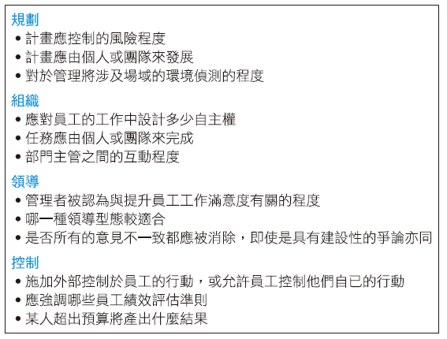
How Does Organizational Culture Affect Managers?
Distribution of Managerial Activities Across Organizational Levels
2-<number>

Slide 36
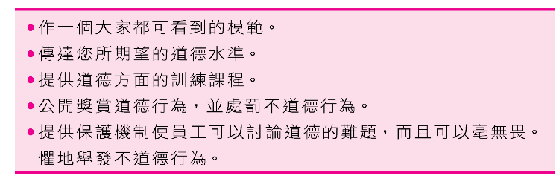
B2-1. Building an Ethical Culture
Higher tolerance for risk.
Low to moderate aggressiveness.
Emphasis on ethical processes in achieving goals—not “ends justify the means.”(不擇手段)
1-<number>

Slide 37
B2-2. Building an Innovative Culture
Encourages employees to challenge
High degree of autonomy in judgment and decision-making
Trust and openness among employees
Time for creative thinking
1-<number>

Slide 38
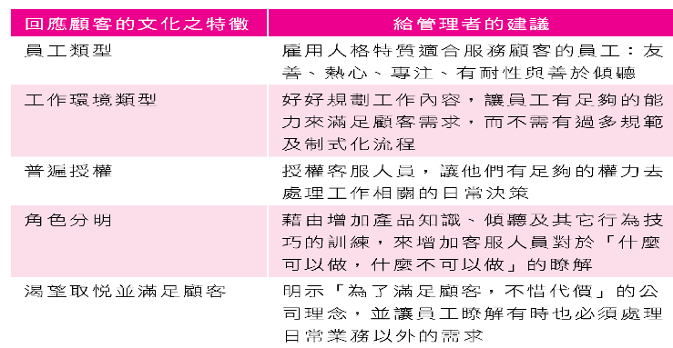
B2-3. Building a Customer-Responsive Culture
1-<number>

Slide 39
B2-4. Building a Diverse Organizational Culture
Differences in gender, race, ethnicity, and age。
Whether the organizational culture can adapt to workforce diversity trends。
Diversity fosters more creative ideas and boosts employee morale.。
1-<number>

Slide 40
B2-5. Cultivating Workplace Spirituality
Five cultural traits of spiritually oriented organizations:
  Strong sense of goal
  Focus on individual development
  Trust and openness
  Employee empowerment
  Tolerance toward employees
1-<number>

